Slide 1

International Islamic University Chittagong
Department Of Computer Science & Engineering
‘Hotel Management System’
Presented by :
Team Binary Wing
Team Leader: Efter Jahan Ema (C193229)
Team Members:
Tehsim Fariha (C193207)
Sahana Akter (C193209)
Raisa Ahmed (C193220)
Submitted to :
Atia Binti Aziz
Adjunct Faculty
Dept Of CSE
IIUC

Slide 2
Introduction:
The project, Hotel Management System is a desktop-based application that allows the hotel manager to handle all hotel activities. Hotel management project provides room booking, staff management and other necessary hotel management features.

Slide 3
Objectives:
To main objective of this project is to provide solution for hotel to manage most there work using computerized process.
This software application will help admin to handle customer information, room allocation details, Payment details etc.
Keeping records of admission of customers. ·
Facilities provided by Hotel are fully utilized in effective and efficient manner

Slide 4
Features:
The application of the Hotel Management System bears the following functions to use by the Administrator:
Add a new Room
Add an Employee
Add a new Customer
Check room status
Check all employees’ details
Check all Customers’ details
Update room status
Update check status etc

Slide 5
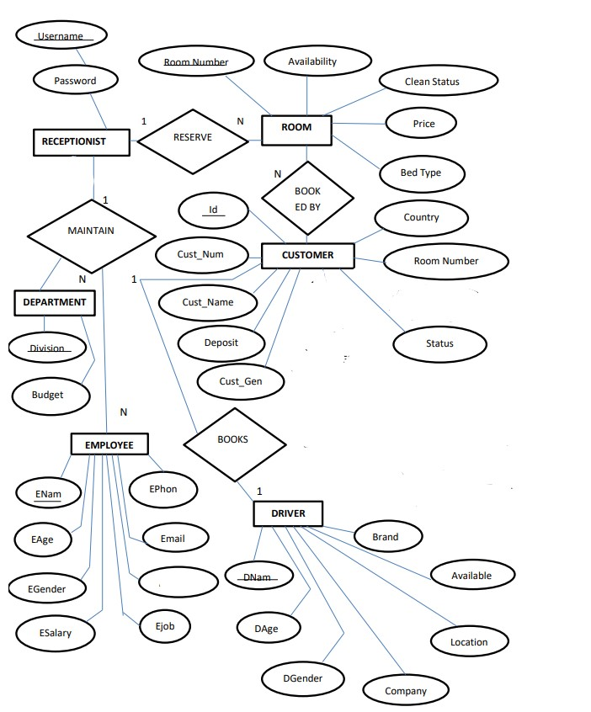
ER Diagram:
ENid

Slide 6
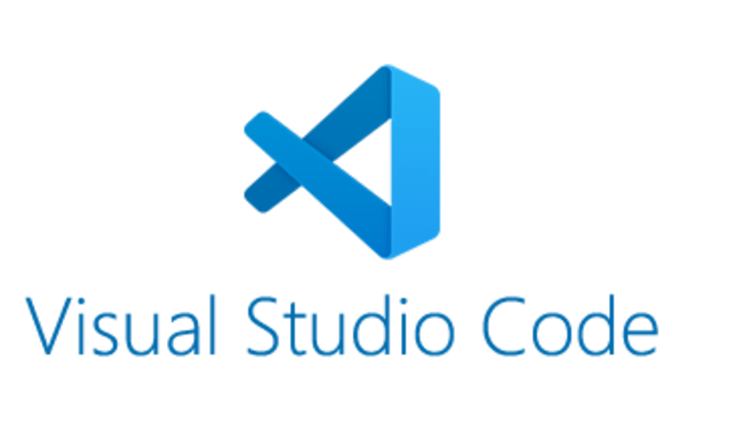



Tools:
Programming Language: Java
Editor: Apache NetBeans.
Backend(Database): MySQL
Frontend : Java Swing package

Slide 7
Front-End:
In our project we use GUI (Graphical User Interface), as a front end. Which is a user-friendly visual experience builder for Java applications. It comprises graphical units like buttons, labels, windows, etc. via which users can connect with an application. Swing are commonly used applications to create GUIs in Java. In our project we have import javax.swing as a package which have all required tools for designing.
Back-End:
This system basically based on back-end development. The software has been designed with backend as Java. Java is an object-oriented programming language, and it meets all the parameters of OOP like inheritance, encapsulation, polymorphism etc. In hotel management system use java language as it defines all OOP features

Slide 8
Software Documentation:
Software documentation is any documentation created to help users or developers understand a piece of software’s features and functions. This type of technical documentation consists of written tutorials, videos, user guides, and training manuals, which aim to aid users in comprehending a piece of software’s features, operations, and functionality.
In our project we refers READ.ME documentation. If anyone want to get full software documentation of our project they can visit in our Github link. : https://github.com/Tehsim/University_Projects/tree/main/software_projects/SE%20Project
Login-> Dashboard
Dashboard-> Hotel Management System-> Reception
Dashboard-> Admin
Admin-> Add Employee, Add Rooms, Add Drivers
Add Employee-> Employee adding form
Add Rooms -> Room adding form
Add Drivers-> Driver Adding form
Reception-> New Customer Form, Room, Department , All Employees, Customer Info, Manager Info, Checkout, Update Status, Update Room Status, Pickup Service, Search Room, Logout.

Slide 9
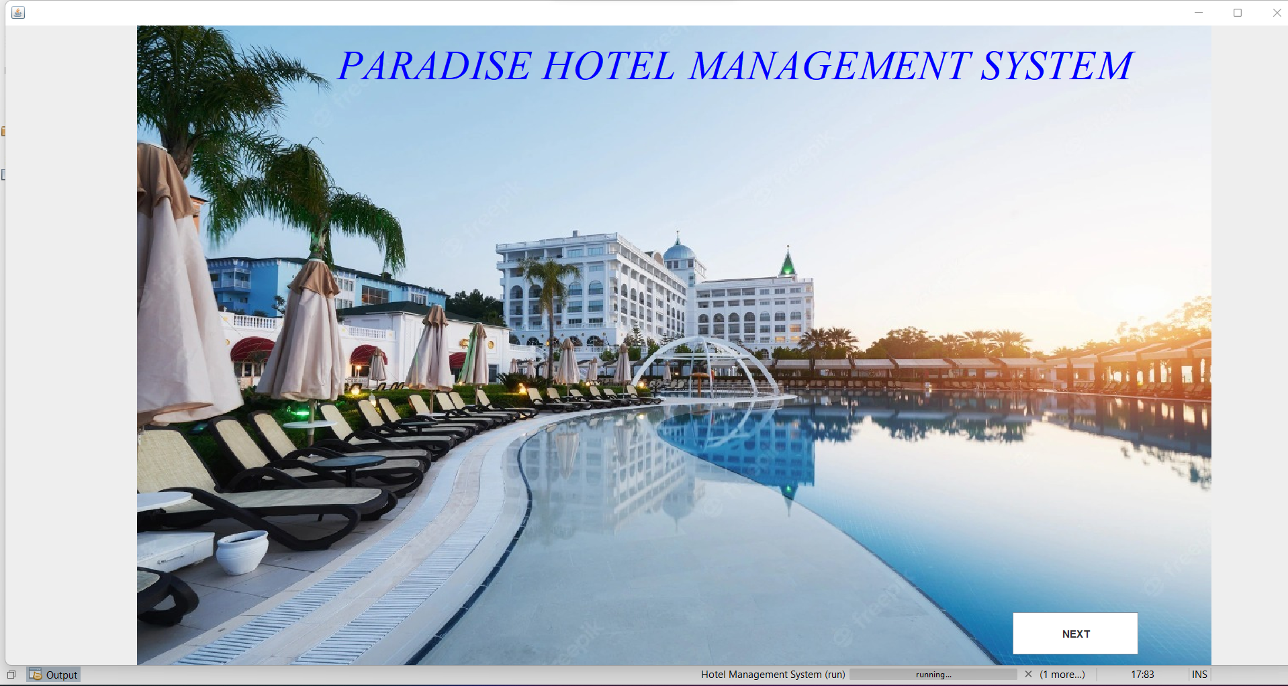
~Welcome to Our Project~

Slide 10
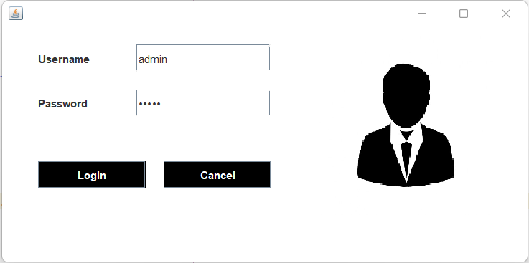
Login window

Slide 11
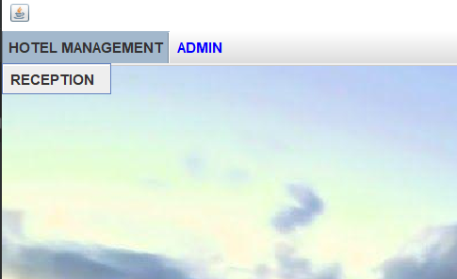
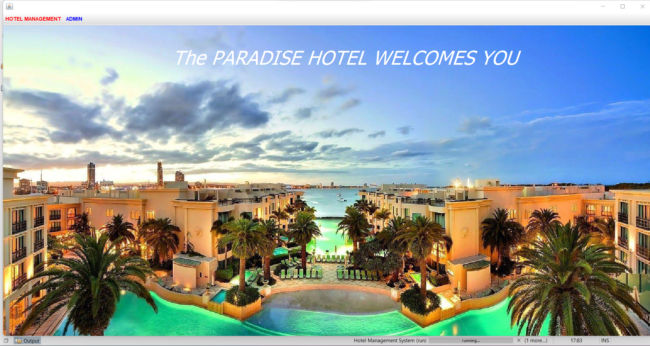
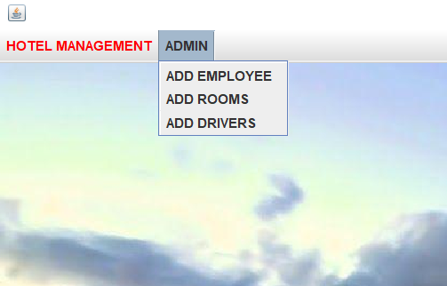
Home Page Design
Dropdown details of the Menubar

Slide 12
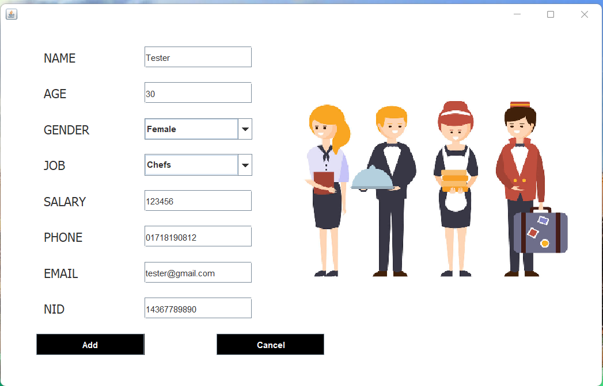
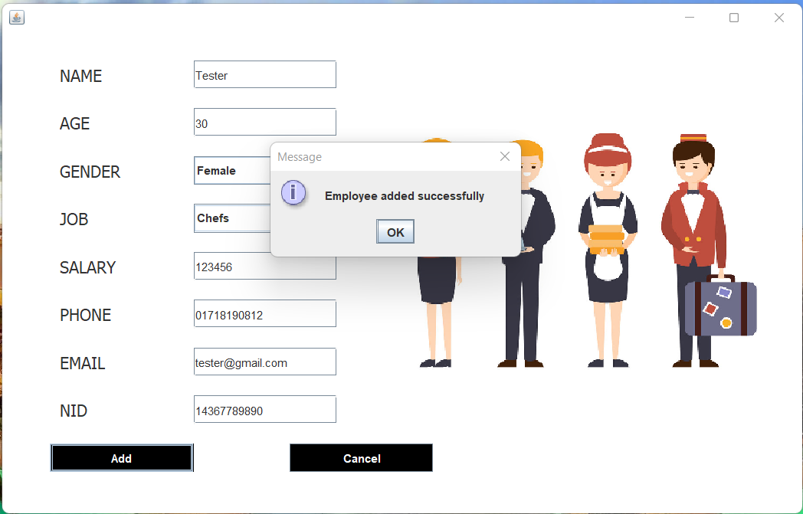
“ADD EMPLOYEE” form design
For adding employees’ information

Slide 13
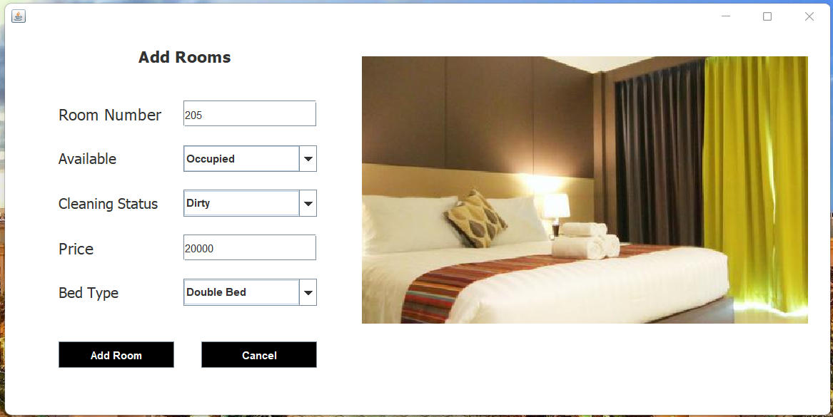
“ADD ROOMS” form design
For adding room details

Slide 14
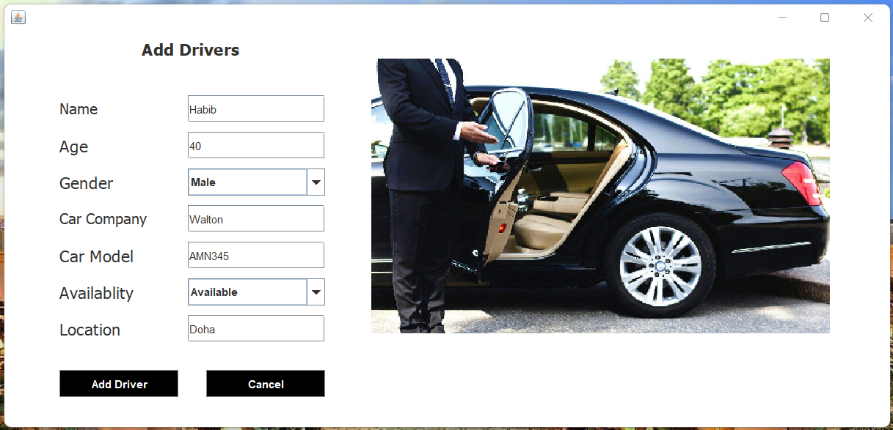
“ADD DRIVERS” form design
For adding drivers’ information

Slide 15
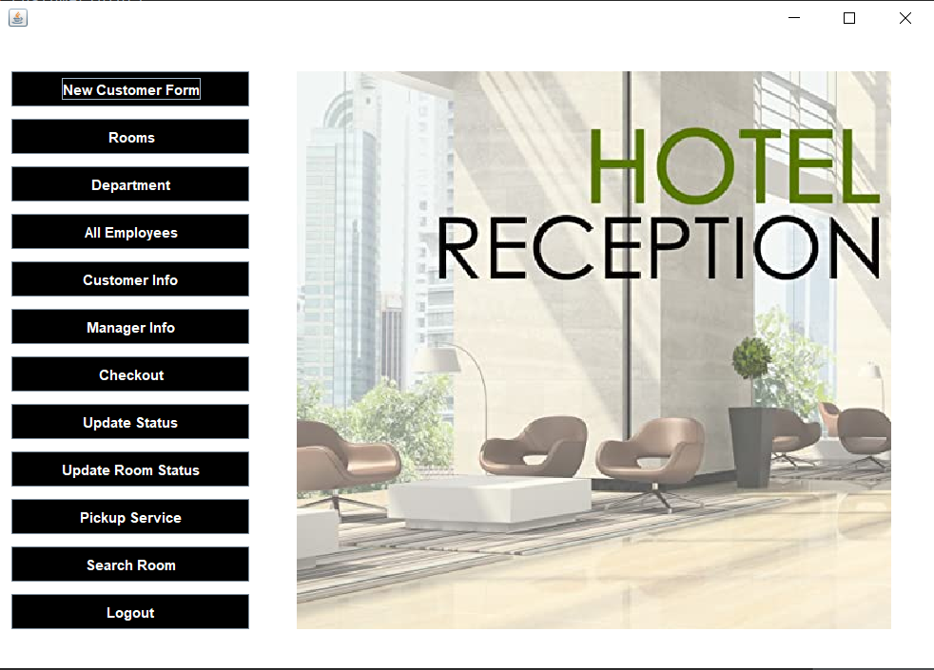
“Reception” page design
For receptionists’ to handle all these features altogether

Slide 16
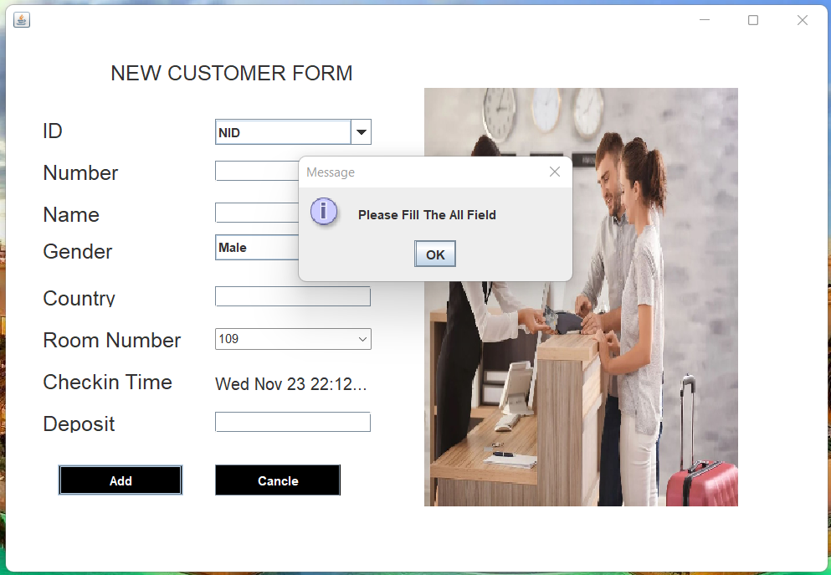
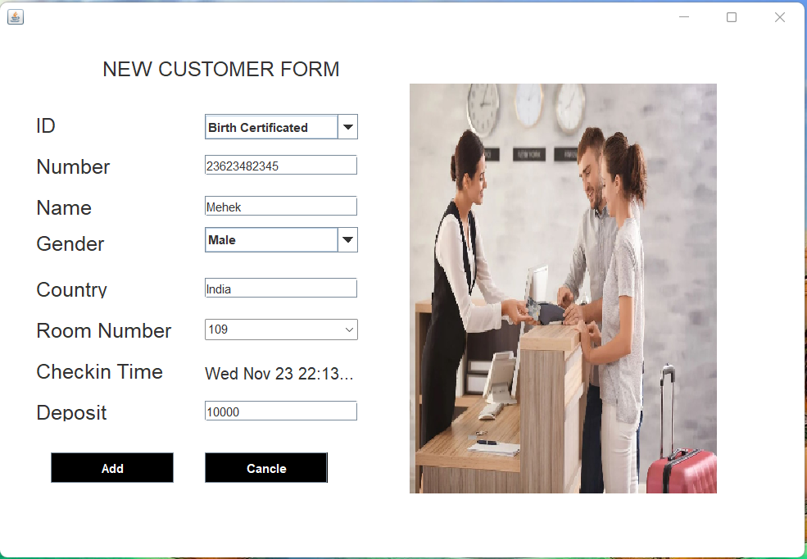
“New Customer Form” design
To put information of customers’ when checking in

Slide 17
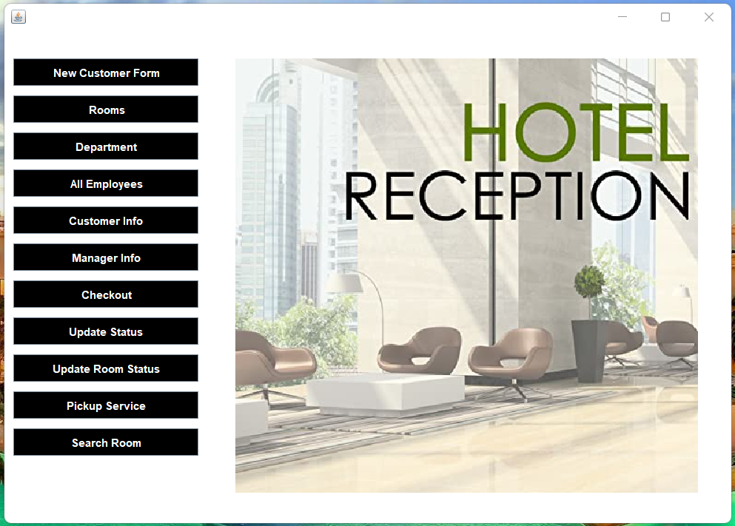
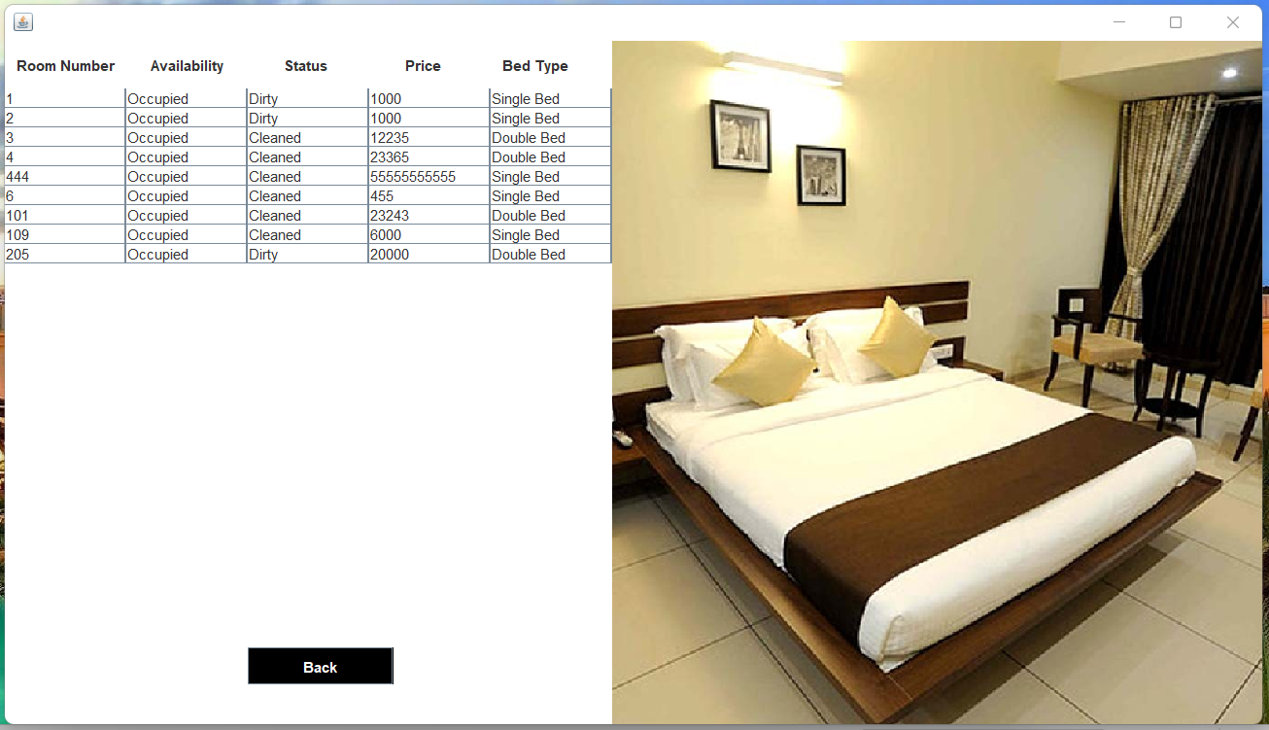
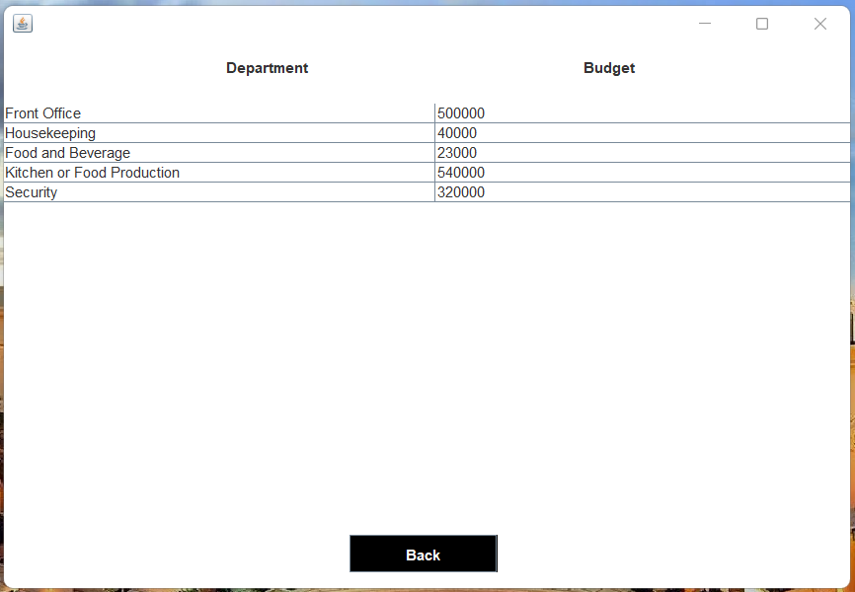
Information of All Rooms
Information of All Departments

Slide 18
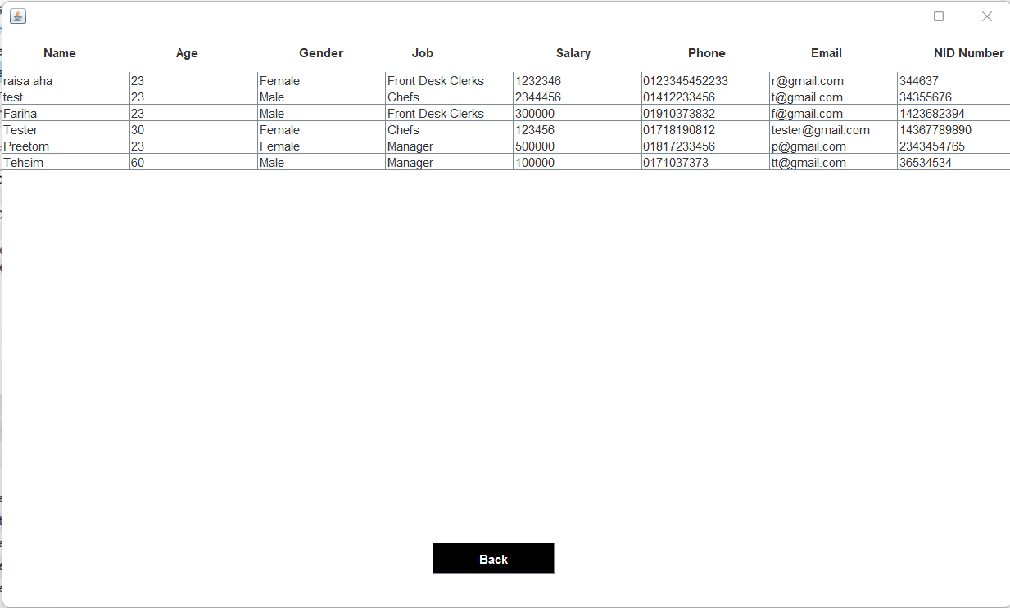
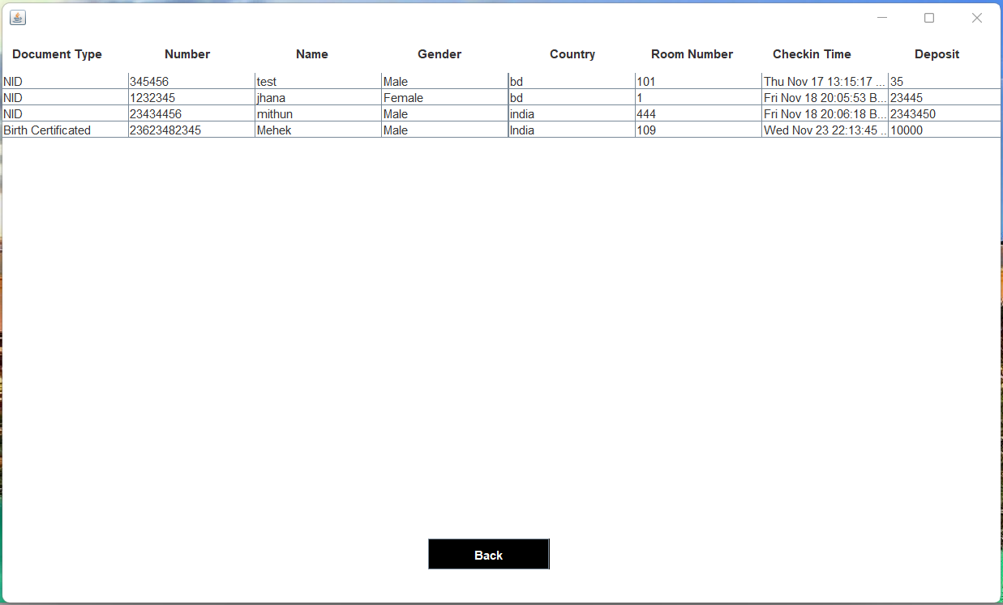
Information of All Employees
Information of All Customers

Slide 19
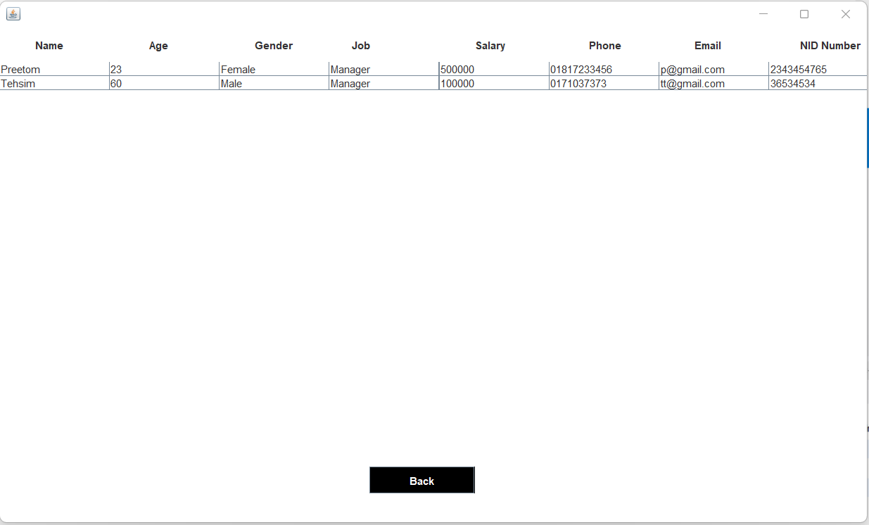
Information of All Managers

Slide 20
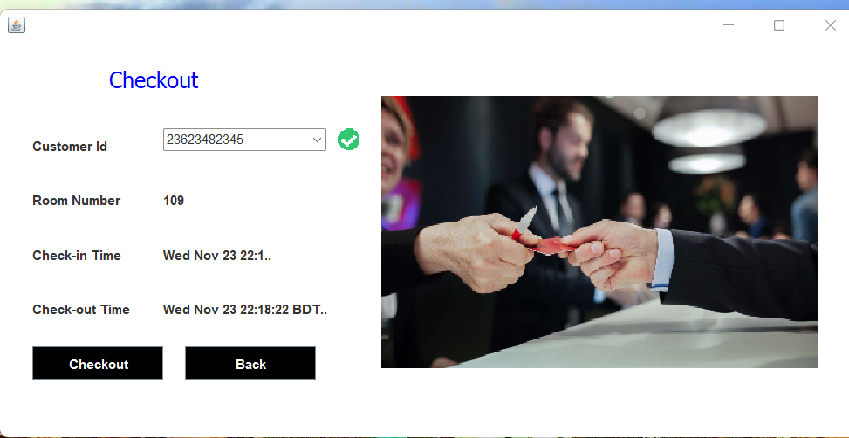
Customer Checkout Feature

Slide 21
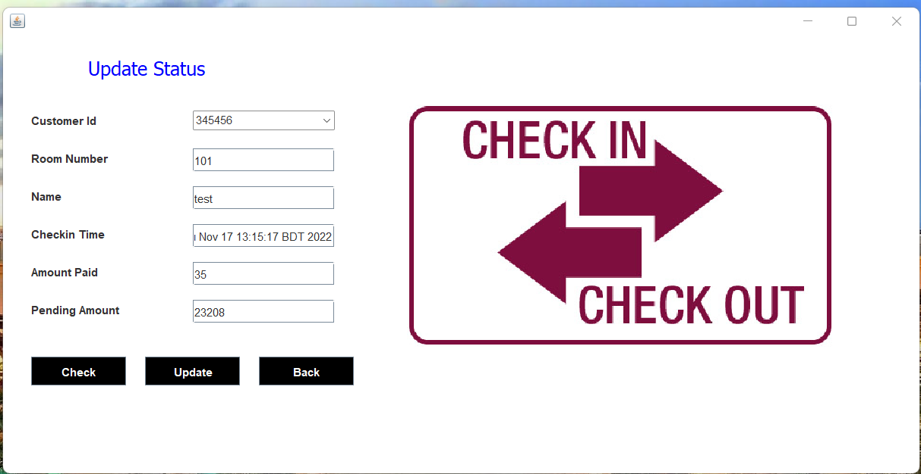
Feature to update status of Customers

Slide 22
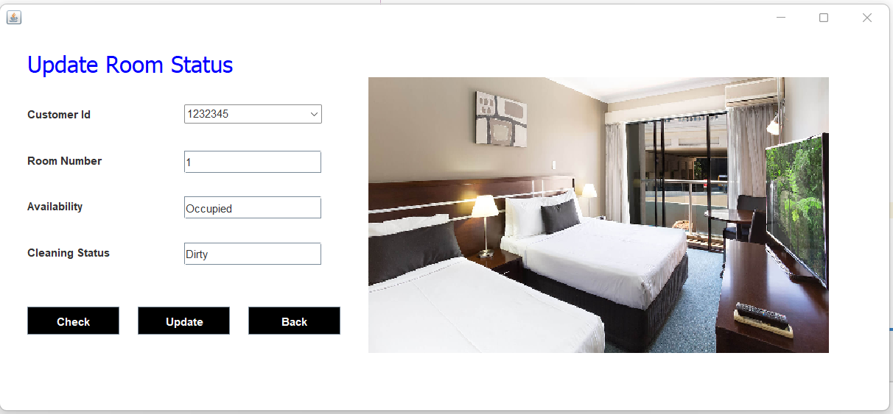
Feature to update room status

Slide 23
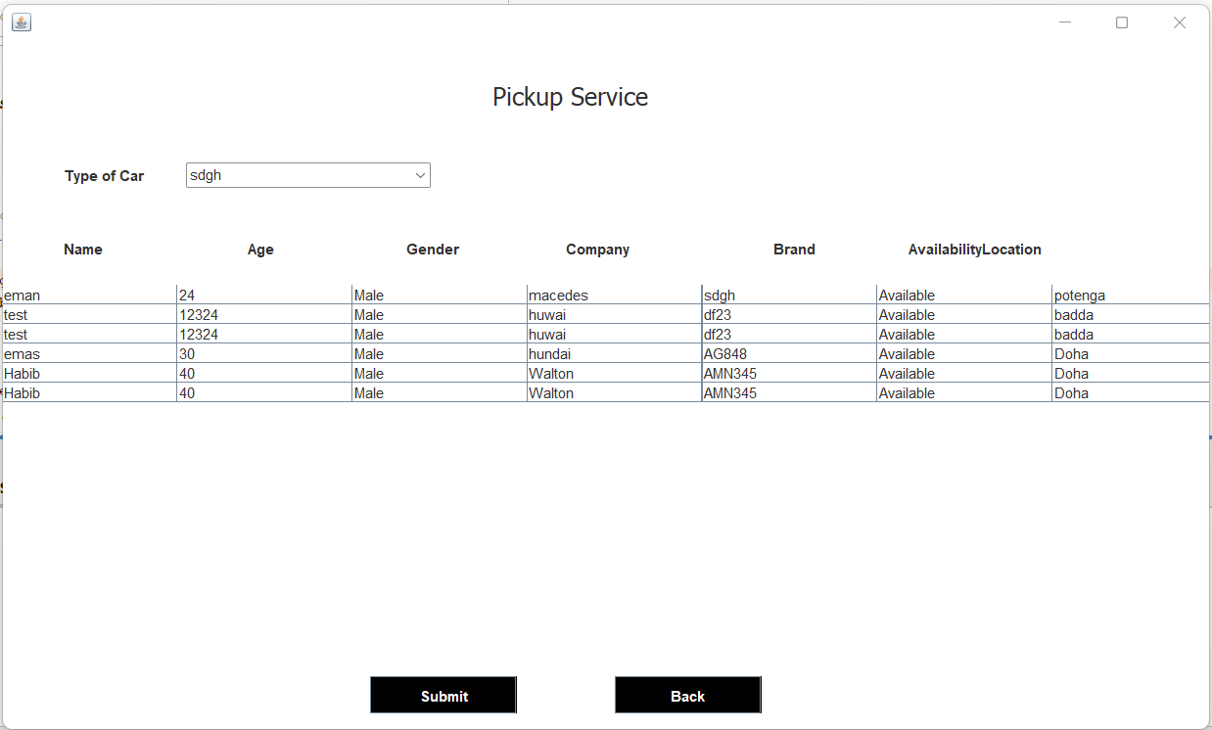
Pickup Service (All Information of vehicles)

Slide 24
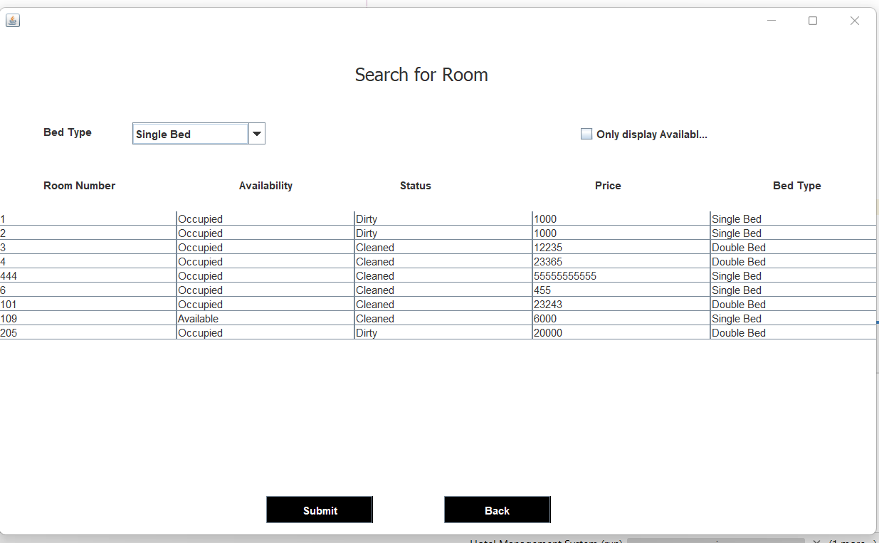
Feature to search for room

Slide 25
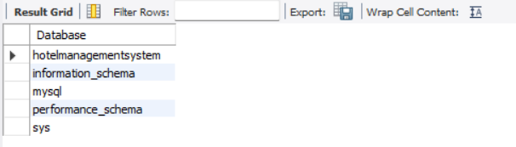
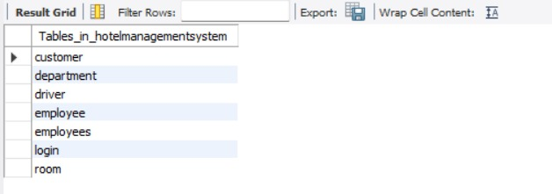
Database:
MySQL-> MySQL is a relational database management system(RDBMS) developed by Oracle that is based on structured query language(SQL).A database is a structured collection of data.
We created a We create a “hotelmanagementsystem “ Database
All Database Tables created under hotel management system:

Slide 26
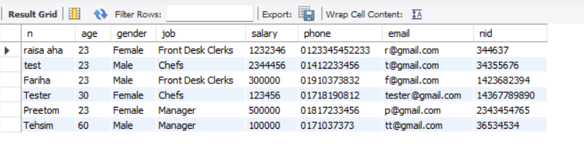
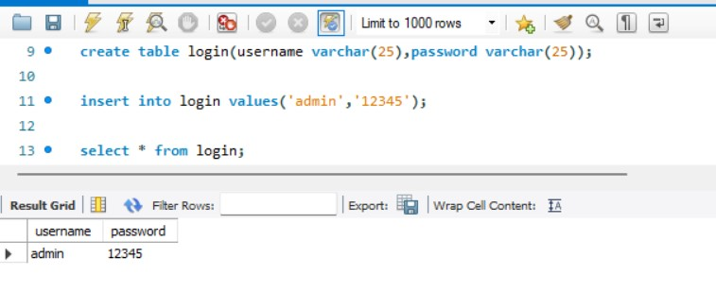
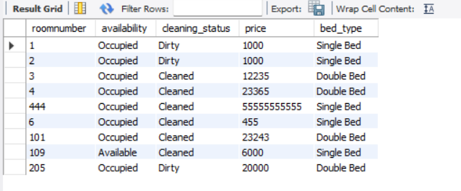
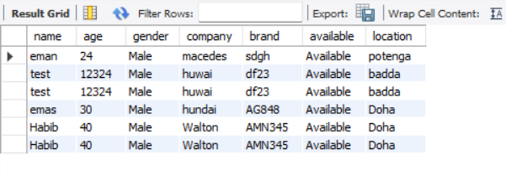
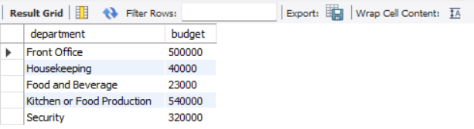
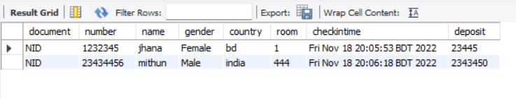
Employee database
Login database
Room Database
Driver Database
Department Database
Customer Database

Slide 27
Limitations of this system:
There's no deletion process of any employees.
As its a admin based software , no other person use it externally
No feature to receive customer’s feedback.
Future scope:
Make the software system into Website based
Add Laundry system
Add Restaurant system
Add Tourist package and guide system
Add Meeting and conference facility

Slide 28
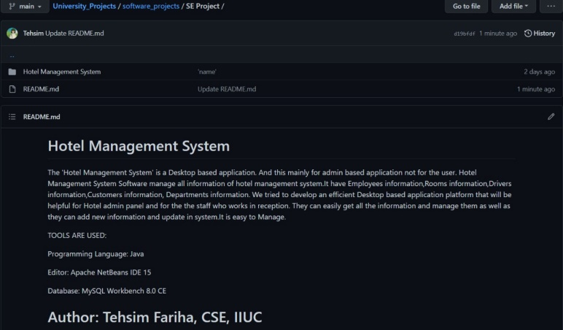
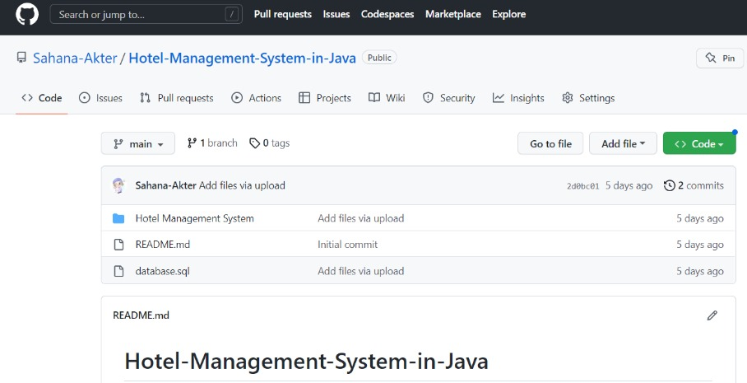
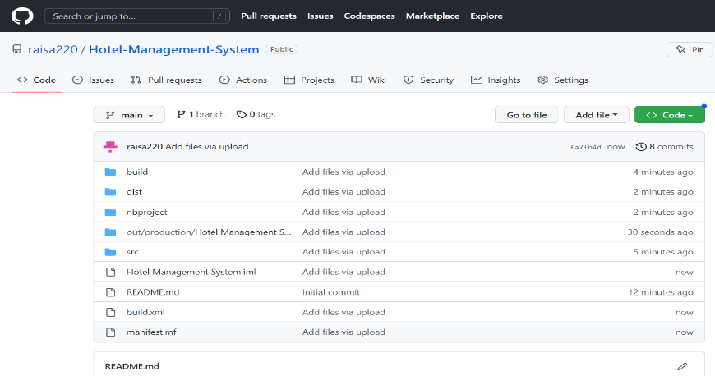
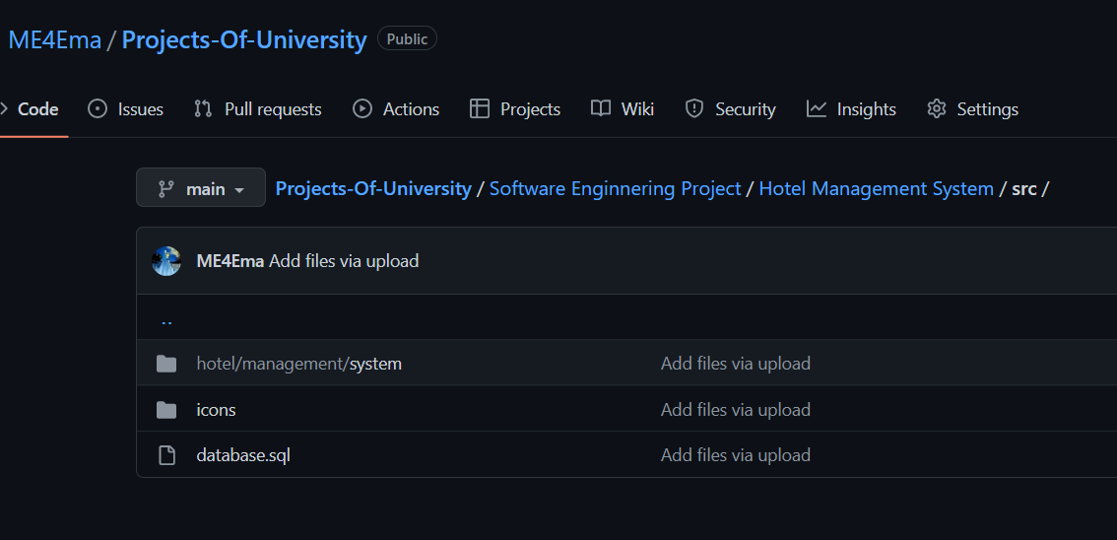
Github link of our project (Individually):
C193207 (Tehsim Fariha) : https://github.com/Tehsim/University_Projects/tree/main/software_projects/SE%20Project
C193209 (Sahana Akter) : https://github.com/Sahana-Akter/Hotel-Management-System-in-Java
C193220 (Raisa Ahmed) : https://github.com/raisa220/Hotel-Management-System.git
C193229 (Efter Jahan Ema): https://github.com/ME4Ema/Projects-Of-University/tree/main/Software%20Enginnering%20Project/Hotel%20Management%20System/src
Tehsim Fariha
Sahana Akter
Raisa Ahmed
Efter Jahan Ema

Slide 29
Thank You

